Slide 1

14 July 2026
Next-Gen MDM Matching: Build Master Data quickly and easily with Adaptive AI Matching
Prasuna Hemanth Raj, Senior Product Manager

Slide 2
Housekeeping Tips
Today's session is scheduled for 1 hour and will feature a presentation followed by a Q&A session at the end.
To ensure a smooth presentation without interruptions, all participants will be muted.
Please submit your questions to "All Panelists" using the Q&A panel. We look forward to answering them during the live Q&A.
This session is being recorded. The recording and slide deck will be available on our Success Portal, and a recorded link will be emailed to you after the event.
We value your input! Please take a moment to complete the post-webinar survey to share your feedback and suggest future topics.
Footer
2

Slide 3





Feature Rich Success Portal
Bootstrap trial and POC Customers
Enriched Customer Onboarding experience
Product Learning Paths and Weekly Expert Sessions
Informatica
Concierge
Tailored training and content recommendations
3
3

Slide 4




More Information
Success Portal
Communities & Support
Documentation
University
https://success.informatica.com
https://network.informatica.com
https://docs.informatica.com
https://www.informatica.com/in/services-and-training/informatica-university.html
4

Slide 5
Safe Harbor
Disclaimer: The information being provided herein is for informational purposes only. The development, release and timing of any Informatica product, service or functionality described herein remain at the sole discretion of Informatica and should not be relied upon in making a purchasing decision. Statements made herein are based on information currently available, which is subject to change. Such statements should not be relied upon as a representation, warranty or commitment to deliver specific products, services or functionality in the future.

Slide 7
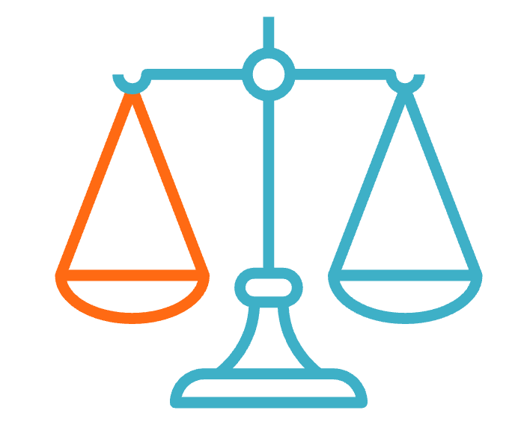
Matching: Need to the Balance Right
Matching is not an exact science, it needs to account for imperfect data.
Match tuning the the art and science of create a balanced match model that suits your organization’s unique needs for creating Matching
Broad Matching
Suitable for:
Anti Money Laundering (AML)
Border control checks
Watchlists Screening
Risk analysis
Narrow Matching
Suitable for:
KYC
Customer delivery
Marketing campaigns with high CAC

Slide 8
Process of Matching
task_alt
compare_arrows
Directed AI Matching
Adaptive AI Matching
Controlled, fine grained matching​ with match rules.
E.g. it supports exact match on SSNs, IDs and fuzzy matches on names, addressed etc.
Customized AI match models.
Learns specific business requirements for Matching through training by data stewards.

Slide 9
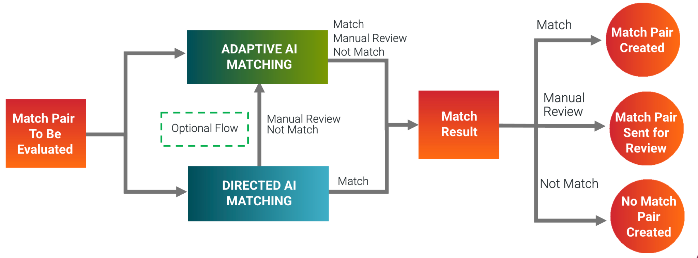
Directed and Adaptive AI Work Together​

Slide 10
Benefits of Adaptive AI Matching
For New Customers:​
Create a match model within 1-3 hours: Customers can create an adaptive AI model by simply labeling few batches of match pairs as Match, Not Match, or Send for Manual Review.​
Model creation by Business User: Business users—regardless of technical background—can train models directly. The system automatically handles the complex configuration, reducing the need for traditional match rule creation.
For Existing Customers:​
Find missed Matches: Adaptive AI can uncover match pairs previously missed by existing directed rules
Tune Match Rules: Leverage Adaptive AI model in DEV env to identify any changes needed to the match rules, and tune the Directed Match Model

Slide 11
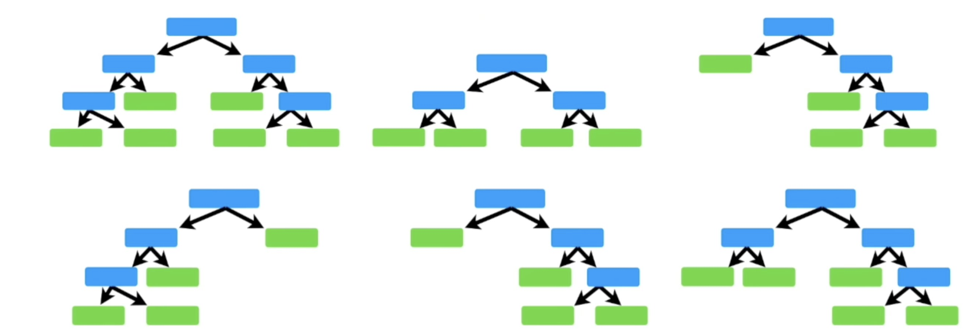
Adaptive AI Matching: How it Works
The Model uses a Random Forest algorithm, to be both accurate & performant.
Data stewards and business users can train the model via a user-friendly interface by labeling pairs as "Match" or "Not Match" in just a few hours.
The results are also fully explainable, providing detailed insights for every match pair through the Match Analysis & Explainability dashboard.

Slide 12
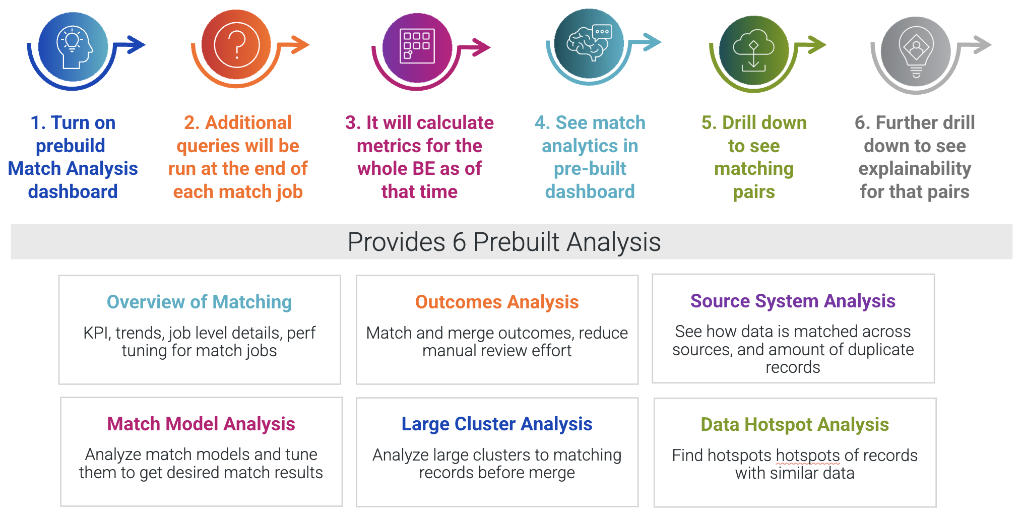
Match Analysis & Explainability

