Slide 1
09-05-2023
Migration Utility - Axon Data Marketplace to Cloud Data Marketplace
Sachin Jain Manager, Customer Success Architect Team
Rashmi Solutions Architect

Slide 2
Agenda
Migration Utility Overview
Process Involved
Demo

Slide 3

Overview - Migration Utility
Utility - Axon Data Marketplace to Cloud Data Marketplace
Governed data is the most valuable dataasets in any organization. Axon data marketplace is the one where user can publish the datasets to consumers to utilize. Now as we move forward to Cloud Data governance and migration of the governance assets would be a challenge. Hence the utility helps the users to migrate the published datasets from Axon data marketplace to cloud data marketplace.

Slide 4


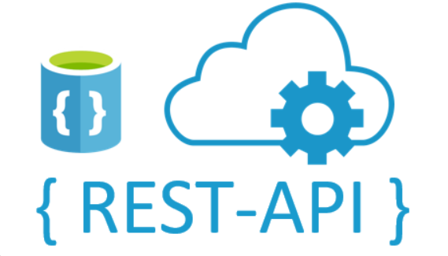
Migration Utility
Utility - Axon Data Marketplace to Cloud Data Marketplace
We make use of REST API to onboard the data from Axon Marketplace to Cloud DataMarketplace
Axon Marketplace
Get list of Published dataset and attributes and its corresponding Categories
{/unison/v1/unison/_search}
Cloud Data Marketplace
Creation of Category : {/cdmp-marketplace/api/v1/categories}
Creation of Data Collection: {/cdmp-marketplace/api/v1/dataCollections}
Creation of Data Assets : {/cdmp-marketplace/api/v1/dataAssets}
Bulk Link to Data Assets to DataCollection : {/cdmp-marketplace/api/v1/dataAssets/linkedDatacollections/bulk}
Axon Data Marketplace
Informatica
Cloud Data Marketplace

Slide 5
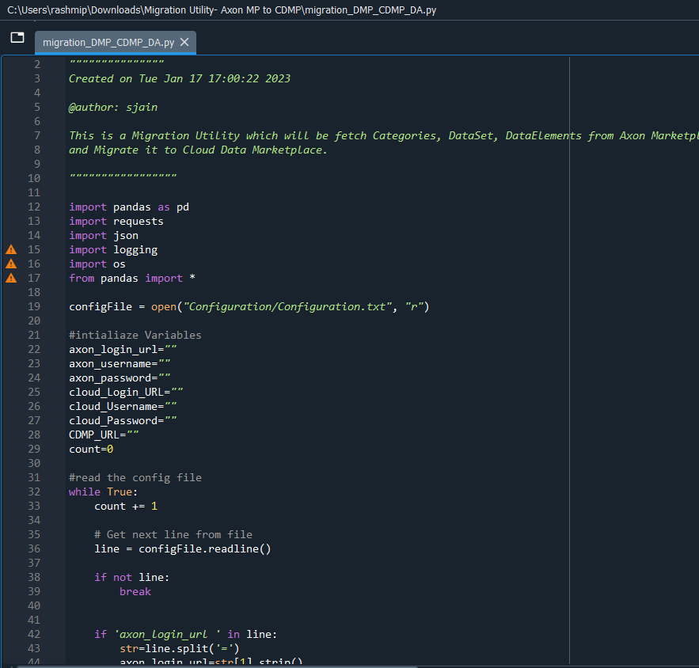
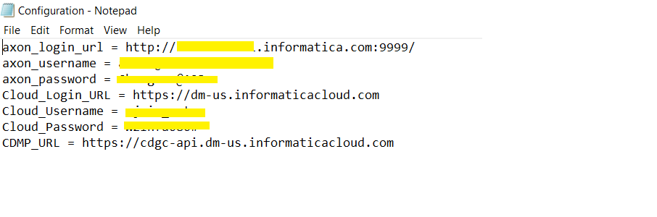
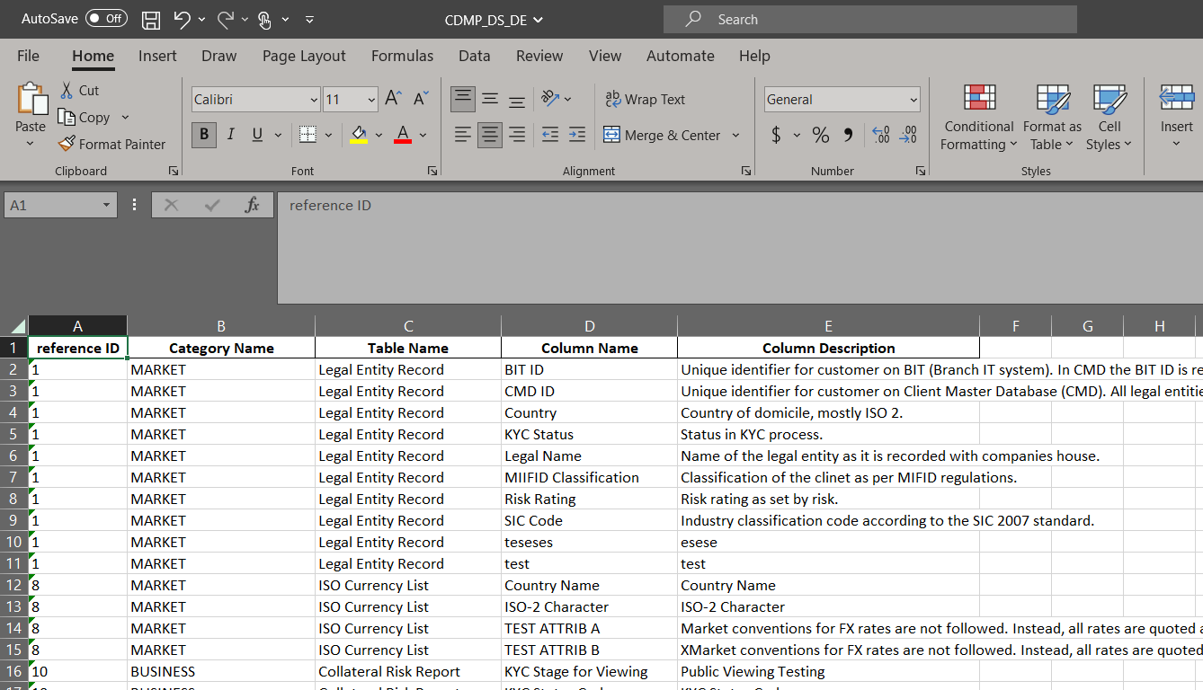
Process Involved
Utility - Axon Data Marketplace to Cloud Data Marketplace
Config file
Disclaimer : Script is just a framework used for the Demo and it needs to be modified based on the requirement

Slide 6
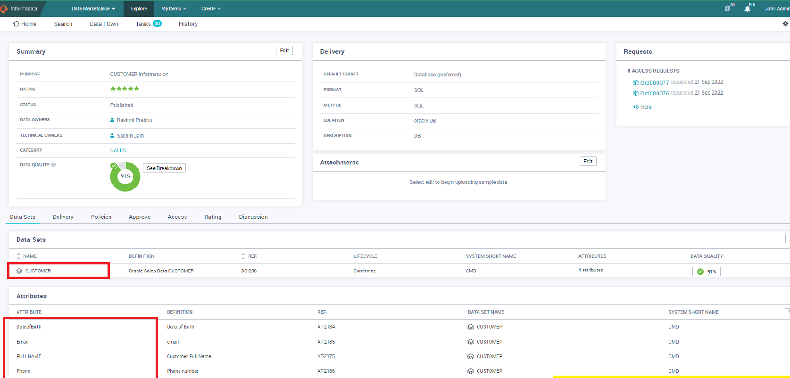
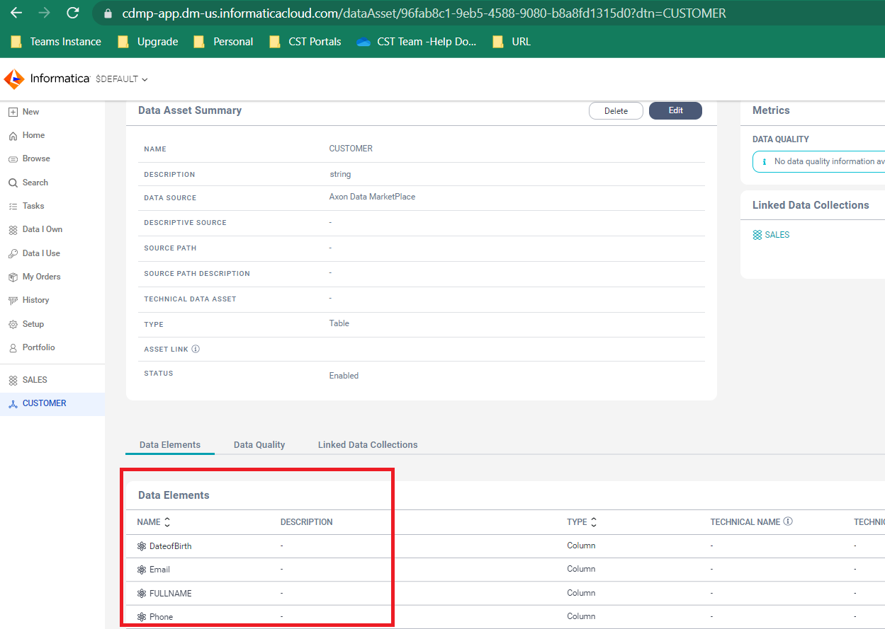
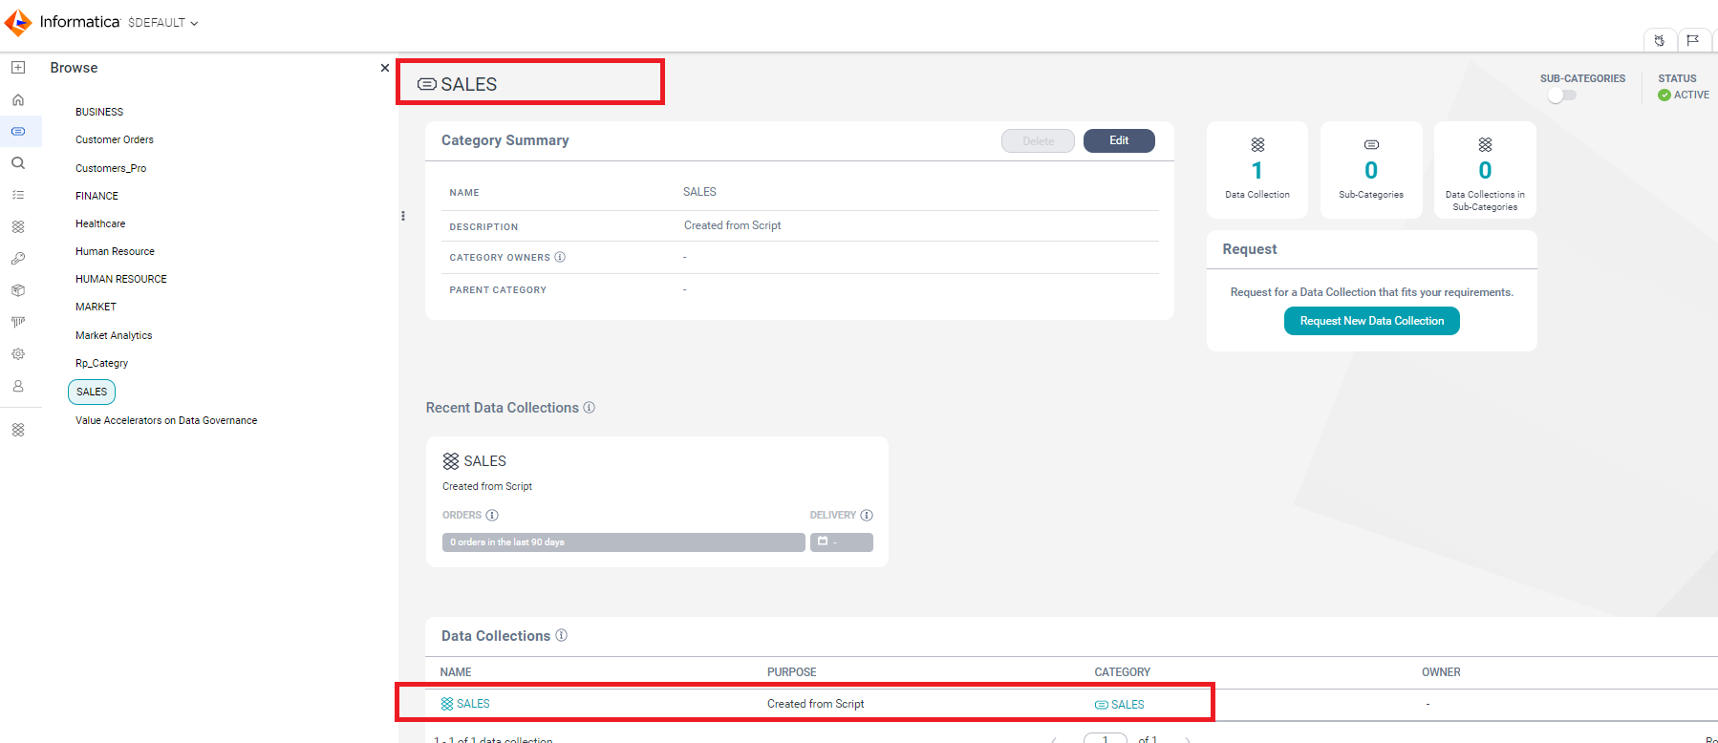
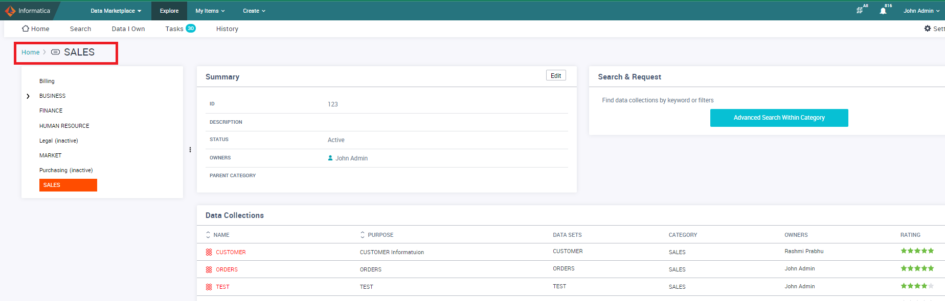
Post Execution :

Slide 7
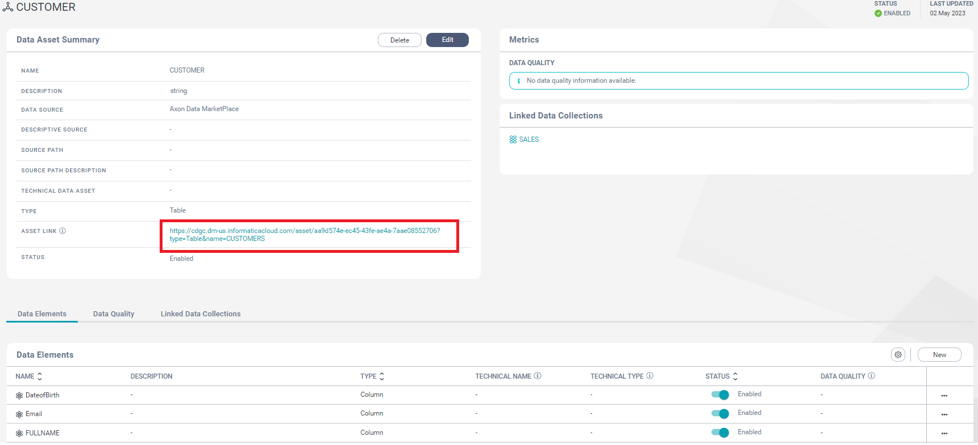
Link Technical Asset to Business Asset
Utility - Axon Data Marketplace to Cloud Data Marketplace​

Slide 8
References
Utility - Axon Data Marketplace to Cloud Data Marketplace​
CDMP API : https://docs.informatica.com/data-governance-and-quality-cloud/data-marketplace/current-version/api-reference/preface.html
Axon API : https://docs.informatica.com/data-quality-and-governance/axon-data-governance/7-3-1/rest-api-guide/rest-api-introduction-and-setup.html
CDMP : https://docs.informatica.com/data-governance-and-quality-cloud/data-marketplace/current-version.html
Sample Script : https://github.com/CustomerSuccessArchitect/Migration-Utility--Axon-MP-to-CDMP.git

Slide 9
Demo

